Slide 1
Continuous Wave Radar
Prepared by :
Amany Soliman Mohamed
Under supervision :
Dr. Moataz Elsherbini

Slide 2
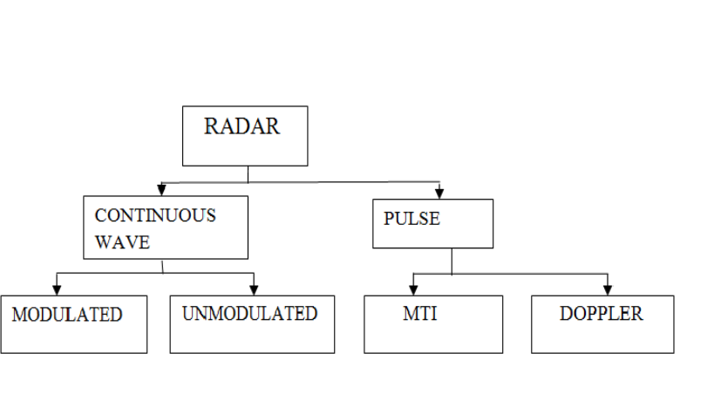
Types of Radar

Slide 3
CW systems
•CW radar
- No range information
- single target
- Unambiguous velocity
information
•FM-CW systems
- measure both range
and velocity
- broaden the transmitted
freq. spectrum
Pulsed Systems
•Pulsed radar
- measurement of range
•Pulsed Doppler radar
- measure both range
and velocity

Slide 4
CONTINUOUS WAVE RADAR
Is a type of radar system where a known stable frequency continuous radio energy is transmitted and then received from any reflecting objects
Simple CW Radar Systems:

Slide 5
Homodyne receiver
TX/RX Isolation required of circulator
- In high-power radars, more isolation may be
required
- Other isolation tech. such as dual antennas
may have to be used.
- sensitivity: low
Doppler freq. :flicker noise is very strong
amplify received signal at a high freq.

Slide 6
Superheterodyne receiver
flicker noise is negligible

Slide 7
Advantage of CW radar
Uses low transmitting power, low power consumption.
simple circuitry, small in size.
Disadvantage of CW radar
Several targets at a given bearing tend to cause confusion.
Range discrimination can be achieved only by introducing very costly complex circuitry.
It is not capable of indicating the range of target an can show only its velocity.
Rather poor TX/ RX isolation

Slide 8
CW Radar and Doppler Effect
CW radar as a speed monitor device
Doppler effect (frequency shift): only indicates for targets moving toward or away from radar

Slide 10
Thank you!!
Questions??

